Slide 1
A2-level
Lesson-3 - adjectives

Slide 2
Contents
Grammar;
Vocabulary
Listening;
Speaking;
Homework

Slide 3
Grammar

Slide 4
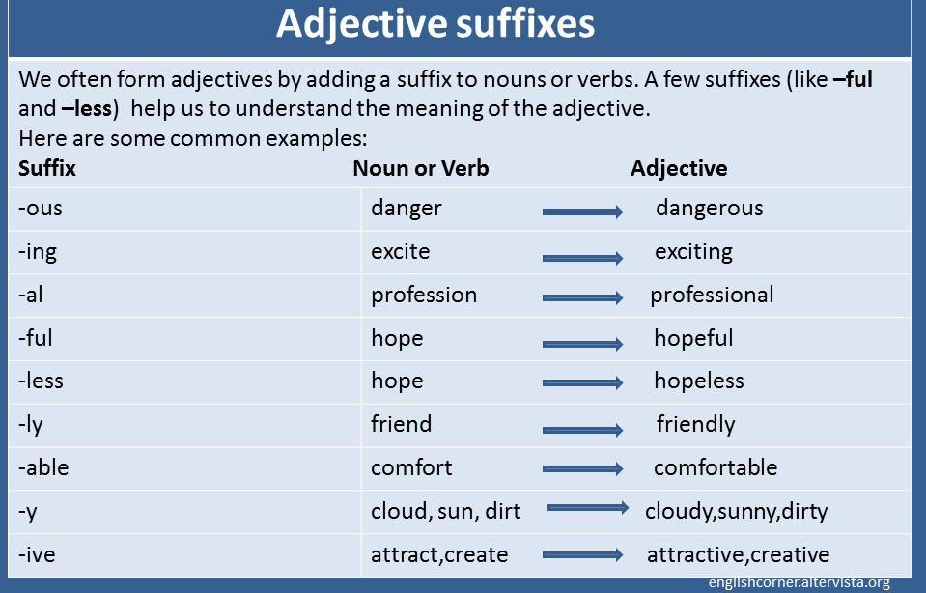
Grammar

Slide 5
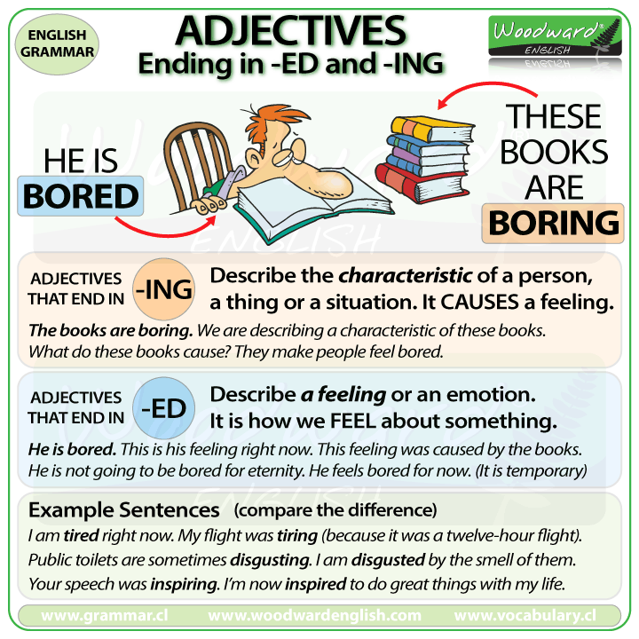
Grammar

Slide 6
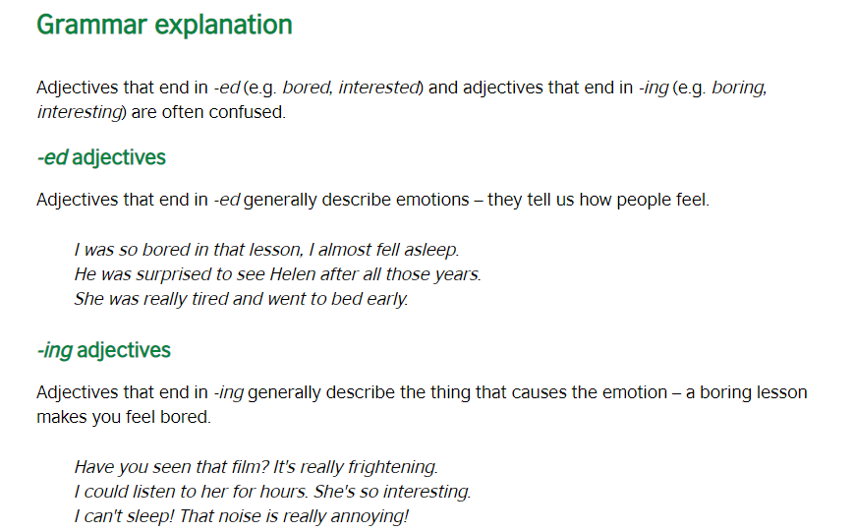
Grammar

Slide 7
Grammar
Ex 5p.121; Ex 8 p 6

Slide 8
Vocabulary
Adjectives describing feelings;
Adjectives describing personality;
Ex3,7

Slide 9
Listening
Listen to the dialogue and speakers, how is each person feeling?
Ex 2,5

Slide 10
Speaking ☺
Part – 1;
Do you mind speaking in public? Why and why not?
Part – 2;
What’s your strengths?
https://www.youtube.com/watch?v=c6VNmbeOKGI

Slide 11
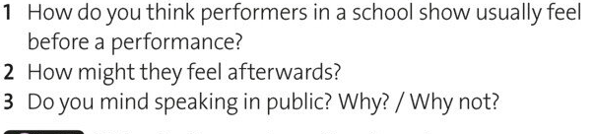
Homework

Slide 14
resources
https://www.esolcourses.com/content/exercises/grammar/adjectives/personality/more-words-for-describing-personality.html
https://7esl.com/adjectives-that-describe-personality/
https://www.vocabulary.cl/Lists/Personality.htm

